Slide 1
Unit 5 - Graph
Suyash Bhardwaj
FET, GKV

Slide 2
Overview
Graph: Definitions of Isomorphism, Components. Circuits, Fundamental Circuits. Cut-Vertices Planer and Dual graphs, Spanning Trees
Graph Theory Algorithms : Algorithms for Connectness, Finding all Spanning Trees in a Weighted Graph and Planarity Testing Breadth First and Depth First Search, Topological Sort, Strongly Connected Components and Aritculation Point. Min-Cut Max-Flow theorem of Network Flows. Ford-Fulkerson Max Flow Algorithms.

Slide 3
Definition of Graphs
A graph is a finite set of nodes with edges between nodes
Formally, a graph G is a structure (V,E) consisting of
a finite set V called the set of nodes, and
a set E that is a subset of VxV. That is, E is a set of pairs of the form (x,y) where x and y are nodes in V

Slide 4
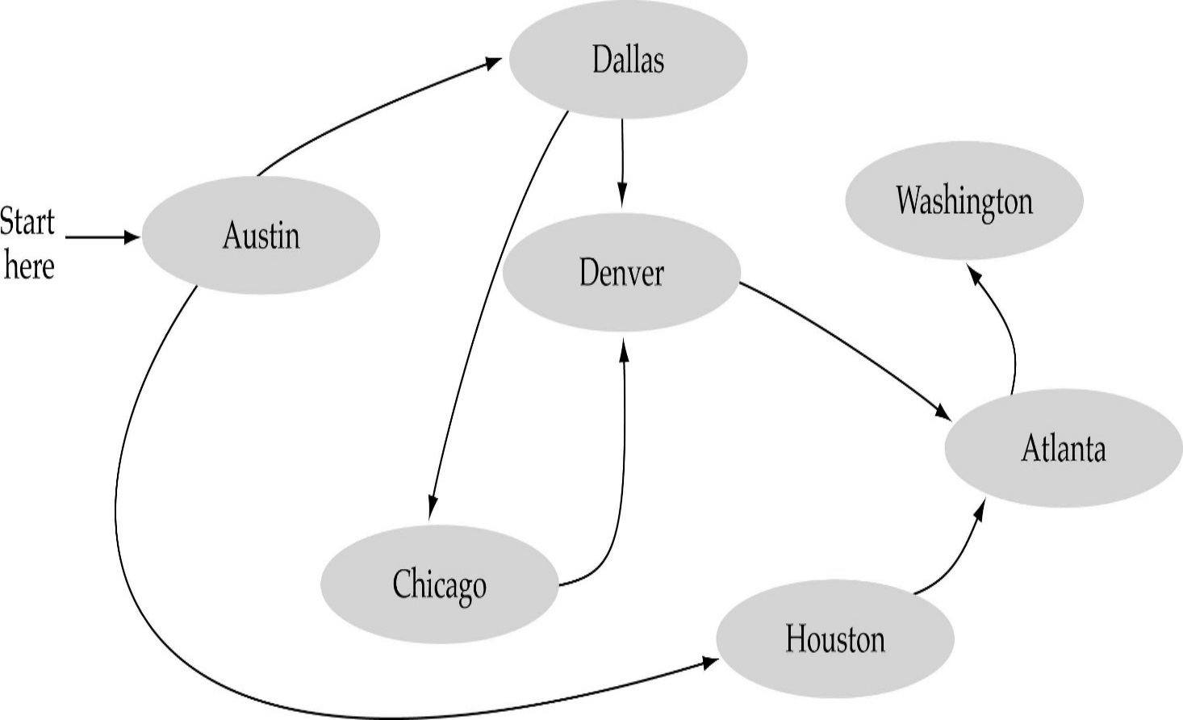
What is a graph?
The set of edges describes relationships among the vertices

Slide 5
Formal definition of graphs
A graph G is defined as follows:
G=(V,E)
V(G): a finite, nonempty set of vertices
E(G): a set of edges (pairs of vertices)

Slide 6
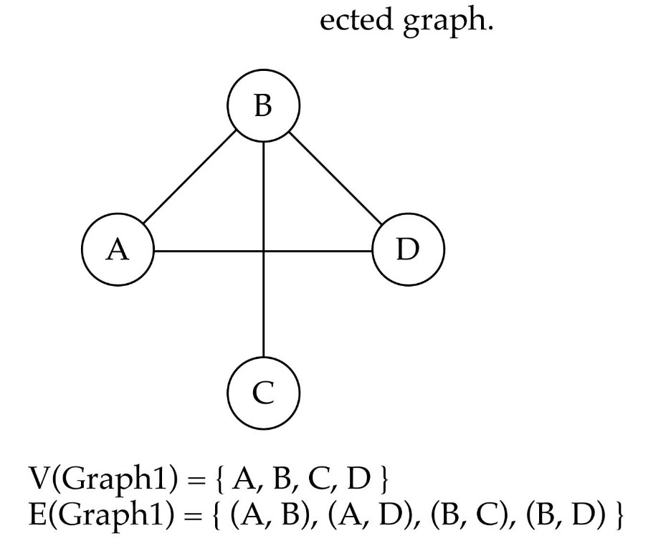
Directed vs. undirected graphs
When the edges in a graph have no direction, the graph is called undirected

Slide 7

Directed vs. undirected graphs (cont.)
When the edges in a graph have a direction, the graph is called directed (or digraph)
Warning: if the graph is directed, the order of the vertices in each edge is important !!
E(Graph2) = {(1,3) (3,1) (5,9) (9,11) (5,7)

Slide 8

Trees vs graphs
Trees are special cases of graphs!!

Slide 9

Graph terminology
Adjacent nodes: two nodes are adjacent if they are connected by an edge
Path: a sequence of vertices that connect two nodes in a graph
Complete graph: a graph in which every vertex is directly connected to every other vertex

Slide 10
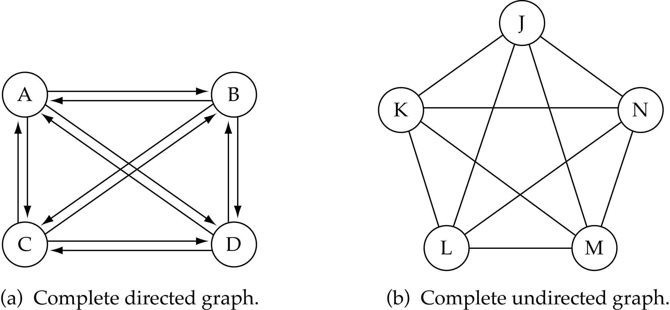
Graph terminology (cont.)
What is the number of edges in a complete directed graph with N vertices?
N * (N-1)

Slide 11
Graph terminology (cont.)
What is the number of edges in a complete undirected graph with N vertices?
N * (N-1) / 2

Slide 12
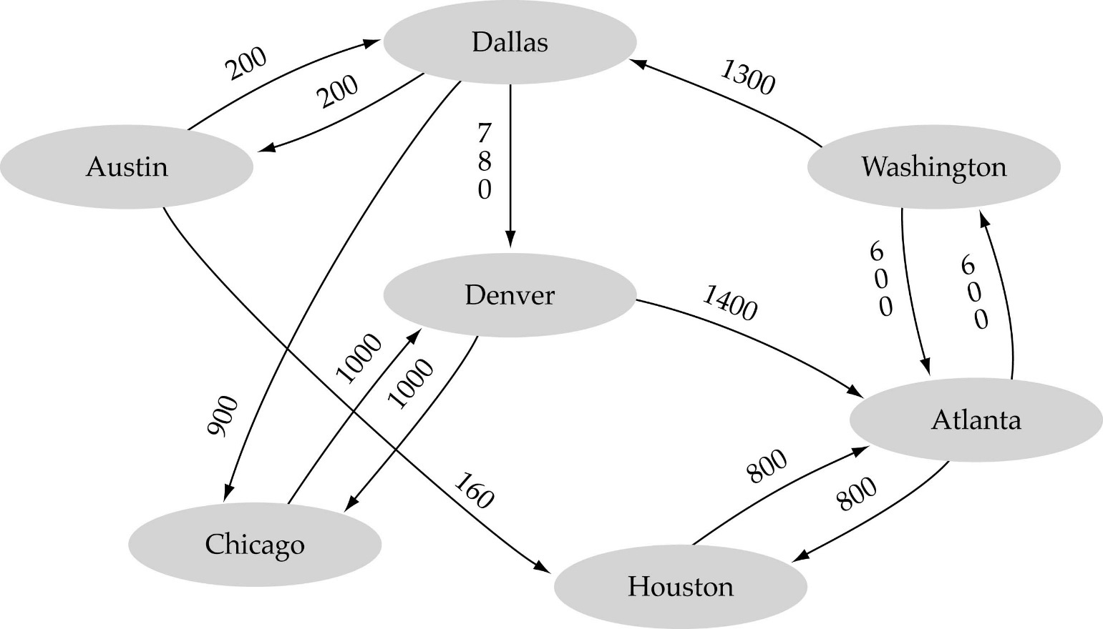
Graph terminology (cont.)
Weighted graph: a graph in which each edge carries a value

Slide 13
Isomorphism
Def :
Let G = {V,E} and G′ = {V ′,E′} be graphs. G and G′ are said to be isomorphic if there exist a pair of functions
f :V →V ′ and g : E → E′
such that f associates each element in V with exactly one element in V ′ and vice versa; g associates each element in E with exactly one element in E′ and vice versa, and for each v ∈V , and each e∈ E , if v is an endpoint of the edge e, then f (v) is an endpoint of the edge g(e).

Slide 14
Isomorphism
If two graphs are isomorphic, they must have:
- the same number of vertices
- the same number of edges
- the same degrees for corresponding vertices
- the same number of connected components
- the same number of loops
- the same number of parallel edges.
- both graphs are connected or both graphs are not connected, and
- pairs of connected vertices must have the corresponding pair of vertices connected.

Slide 15
Consider two graphs
Firstly, label the graphs.

Slide 16
Now check for each property

Slide 17
Number of vertices: both 5.
Number of edges: both 5.
Degrees of corresponding vertices: all degree 2.
Connectedness: Each is fully connected.
Number of connected components: Both 1.
Pairs of connected vertices: All correspond.
Number of loops: 0.
Number of parallel edges: 0.
Everything is equal and so the graphs are isomorphic.

Slide 18
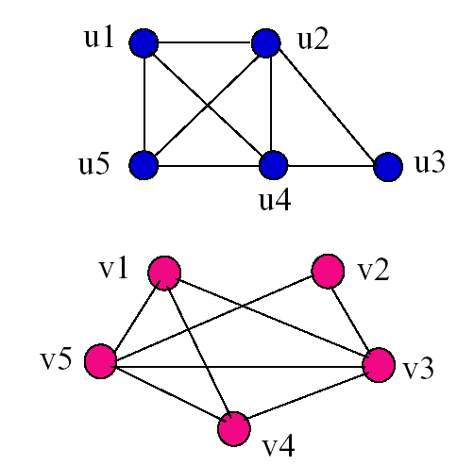
Examples
Determine if the following two graphs G₁ and G₂ are isomorphic:

Slide 19

Graph implementation
Array-based implementation
A 1D array is used to represent the vertices
A 2D array (adjacency matrix) is used to represent the edges

Slide 20
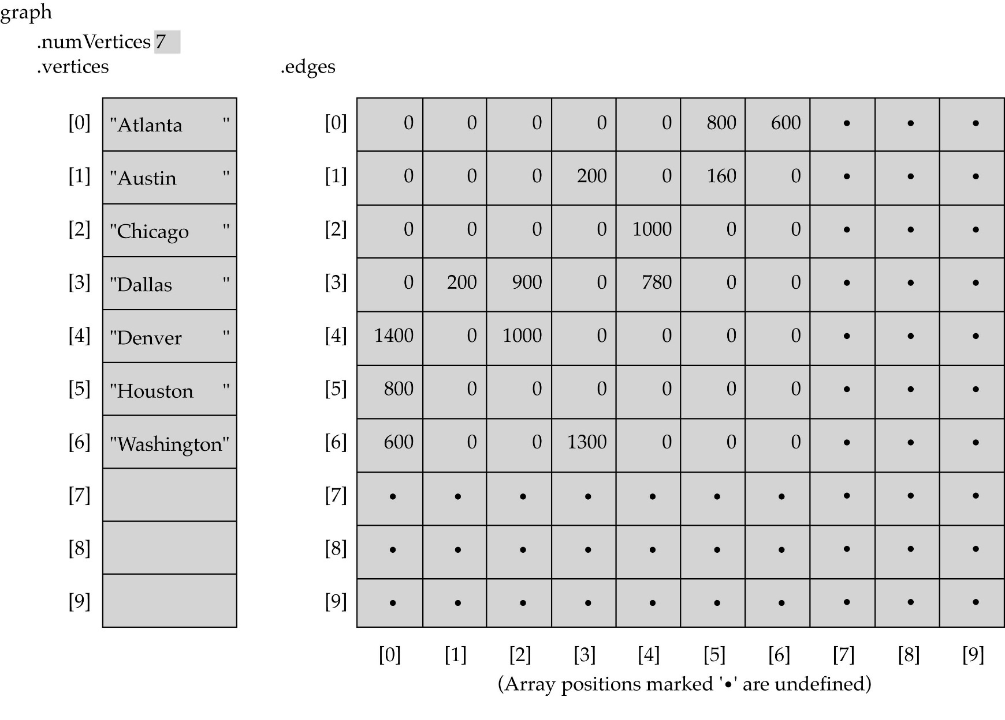
Array-based implementation

Slide 21

Graph implementation (cont.)
Linked-list implementation
A 1D array is used to represent the vertices
A list is used for each vertex v which contains the vertices which are adjacent from v (adjacency list)

Slide 22
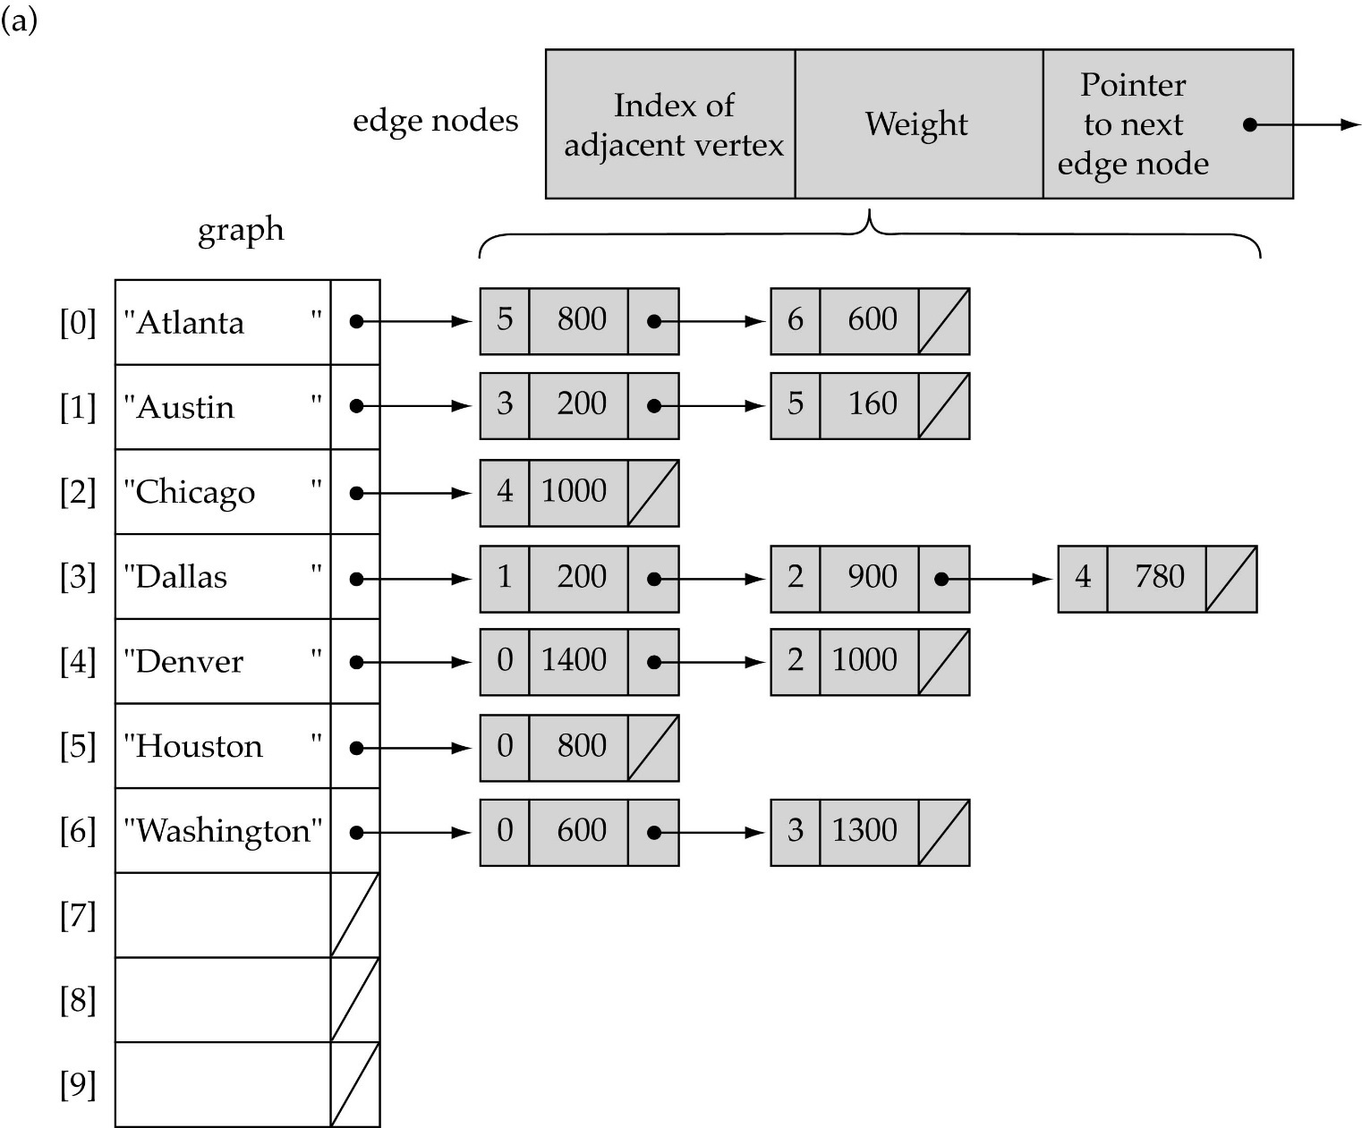
Linked-list implementation

Slide 23
Adjacency matrix vs. adjacency list representation
Adjacency matrix
Good for dense graphs --|E|~O(|V|²)
Memory requirements: O(|V| + |E| ) = O(|V|² )
Connectivity between two vertices can be tested quickly
Adjacency list
Good for sparse graphs -- |E|~O(|V|)
Memory requirements: O(|V| + |E|)=O(|V|)
Vertices adjacent to another vertex can be found quickly

Slide 24
Graph searching
Problem: find a path between two nodes of the graph (e.g., Austin and Washington)
Methods: Depth-First-Search (DFS) or Breadth-First-Search (BFS)

Slide 25
Depth-First-Search (DFS)
What is the idea behind DFS?
Travel as far as you can down a path
Back up as little as possible when you reach a "dead end" (i.e., next vertex has been "marked" or there is no next vertex)
DFS can be implemented efficiently using a stack

Slide 26
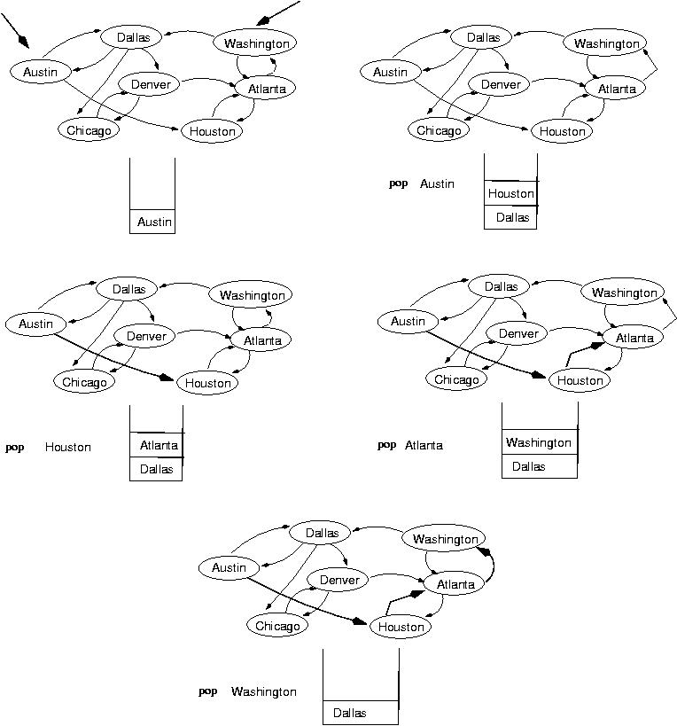
start
end
(initialization)

Slide 29
Breadth-First-Searching (BFS)
What is the idea behind BFS?
Look at all possible paths at the same depth before you go at a deeper level
Back up as far as possible when you reach a "dead end" (i.e., next vertex has been "marked" or there is no next vertex)
BFS can be implemented efficiently using a queue

Slide 30
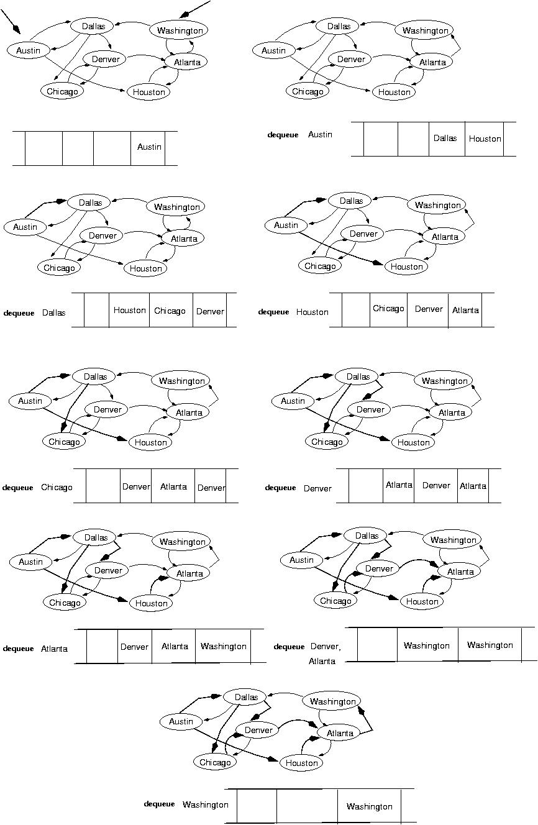
start
end
(initialization)

Slide 31
next:

Slide 33
Single-source shortest-path problem
There are multiple paths from a source vertex to a destination vertex
Shortest path: the path whose total weight (i.e., sum of edge weights) is minimum
Examples:
Austin->Houston->Atlanta->Washington: 1560 miles
Austin->Dallas->Denver->Atlanta->Washington: 2980 miles

Slide 34
Single-source shortest-path problem (cont.)
Common algorithms: Dijkstra's algorithm, Bellman-Ford algorithm
BFS can be used to solve the shortest graph problem when the graph is weightless or all the weights are the same
(mark vertices before Enqueue)

Slide 35
Planar Graphs
Planar graphs are graphs that can be drawn in the plane without edges having to cross.
Understanding planar graph is important:
Any graph representation of maps/ topographical information is planar.
graph algorithms often specialized to planar graphs (e.g. traveling salesperson)
Circuits usually represented by planar graphs

Slide 36
Planar Graphs -Common Misunderstanding
Just because a graph is drawn with edges crossing doesn’t mean its not planar.
Q: Why can’t we conclude that the following is non-planar?

Slide 37
Planar Graphs -Common Misunderstanding
A: Because it is isomorphic to a graph which is planar:

Slide 38
Example of Planarity 3-Cube

Slide 39
Regions
The first invariant of a planar graph will be the number of regions that the graph defines in the plane. A region is a part of the plane completely disconnected off from other parts of the plane by the edges of the graph.
EG: the car graph has 4 regions:
4
3
1
2

Slide 40
Regions
Q: How many regions does the 3-cube have?

Slide 41
Regions
A: 6 regions
3
6
4
1
2
5

Slide 42
Regions
THM: The number of regions defined by a connected planar graph is invariant of how it is drawn in the plane and satisfies the formula involving edges and vertices:
r = |E | - |V | + 2
EG: Verify formula for car and 3-cube:
4=6-4+2
3
3
6=12-8+2
4
1
2
1
2
5

Slide 43
Definition of Dual Graph
DEF: The dual graph G ^ of a planar graph G = (V, E, R) [Vertices, Edges, Regions] is the graph obtained by setting
Vertices of G ^: V (G ^ ) = R
Edges of G ^: E (G ^ ) = set of edges of the form {F₁,F₂} where F₁ and F₂ share a common edge.

Slide 44
Theorem : If l(Fi) denotes the length of face Fi in a plane graph G, then 2e(G)= Σ l(Fi).
Proof:
The face lengths are the degrees of the dual vertices. Since e(G)=e(G*), the statement 2e(G)=Σ l(Fi) is thus the same as the degree-sum formula 2e(G*)=Σ dG* (x) for G*. (Both sums count each edge twice.)
l = 4
e(G) = 6
l = 5
Σ l(Fi) = 12
l = 3

Slide 45
Spanning Trees

Slide 46
Spanning trees
Suppose you have a connected undirected graph
Connected: every node is reachable from every other node
Undirected: edges do not have an associated direction
...then a spanning tree of the graph is a connected subgraph in which there are no cycles
A connected, undirected graph
Four of the spanning trees of the graph

Slide 47
Finding a spanning tree
To find a spanning tree of a graph,
pick an initial node and call it part of the spanning tree
do a search from the initial node:
each time you find a node that is not in the spanning tree, add to the spanning tree both the new node and the edge you followed to get to it
An undirected graph
One possible result of a BFS starting from top
One possible result of a DFS starting from top

Slide 48
Minimizing costs Real Life Example
Suppose you want to supply a set of houses (say, in a new subdivision) with:
electric power
water
sewage lines
telephone lines
To keep costs down, you could connect these houses with a spanning tree (of, for example, power lines)
However, the houses are not all equal distances apart
To reduce costs even further, you could connect the houses with a minimum-cost spanning tree

Slide 49
Minimum-cost spanning trees
Suppose you have a connected undirected graph with a weight (or cost) associated with each edge
The cost of a spanning tree would be the sum of the costs of its edges
A minimum-cost spanning tree is a spanning tree that has the lowest cost
16
16
A
B
A
B
21
11
6
11
6
19
5
5
F
C
F
C
33
14
10
E
18
D
E
18
D
A connected, undirected graph
A minimum-cost spanning tree

Slide 50
MST
A minimum spanning tree connects all nodes in a given graph
A MST must be a connected and undirected graph
A MST can have weighted edges
Multiple MSTs can exist within a given undirected graph

Slide 51
More about Multiple MSTs
Multiple MSTs can be generated depending on which algorithm is used
If you wish to have an MST start at a specific node
However, if there are weighted edges and all weighted edges are unique, only one MST will exist

Slide 52
Finding spanning trees
There are two basic algorithms for finding minimum-cost spanning trees, and both are greedy algorithms
Kruskal’s algorithm: Start with no nodes or edges in the spanning tree, and repeatedly add the cheapest edge that does not create a cycle
Here, we consider the spanning tree to consist of edges only
Prim’s algorithm: Start with any one node in the spanning tree, and repeatedly add the cheapest edge, and the node it leads to, for which the node is not already in the spanning tree.
Here, we consider the spanning tree to consist of both nodes and edges

Slide 53
Prim’s algorithm Algo
T = a spanning tree containing a single node s; E = set of edges adjacent to s; while T does not contain all the nodes {
remove an edge (v, w) of lowest cost from E
if w is already in T then discard edge (v, w)
else {
add edge (v, w) and node w to T
add to E the edges adjacent to w
}
}
An edge of lowest cost can be found with a priority queue
Testing for a cycle is automatic
Hence, Prim’s algorithm is far simpler to implement than Kruskal’s algorithm

Slide 54
Prim’s Algorithm
Initially discovered in 1930 by Vojtěch Jarník, then rediscovered in 1957 by Robert C. Prim
Similar to Dijkstra’s Algorithm regarding a connected graph
Starts off by picking any node within the graph and growing from there

Slide 55
Prim’s Algorithm Cont.
Label the starting node, A, with a 0 and all others with infinite
Starting from A, update all the connected nodes’ labels to A with their weighted edges if it less than the labeled value
Find the next smallest label and update the corresponding connecting nodes
Repeat until all the nodes have been visited

Slide 56
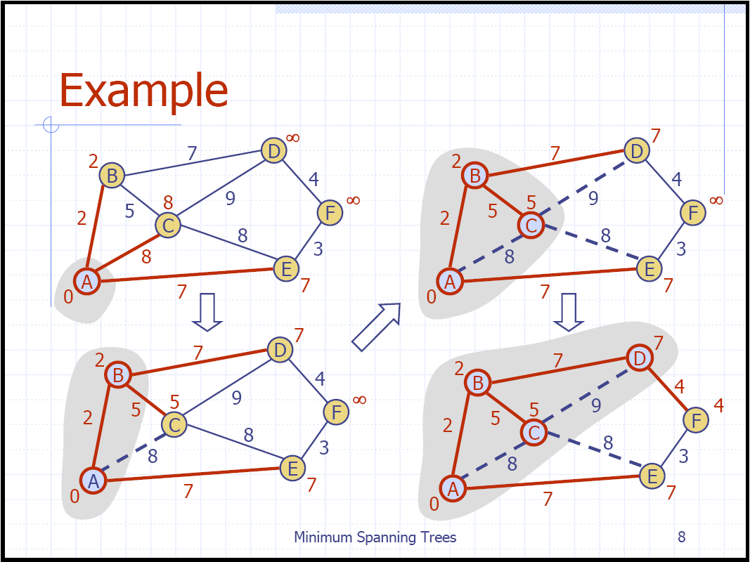
Prim’s Algorithm Example

Slide 57
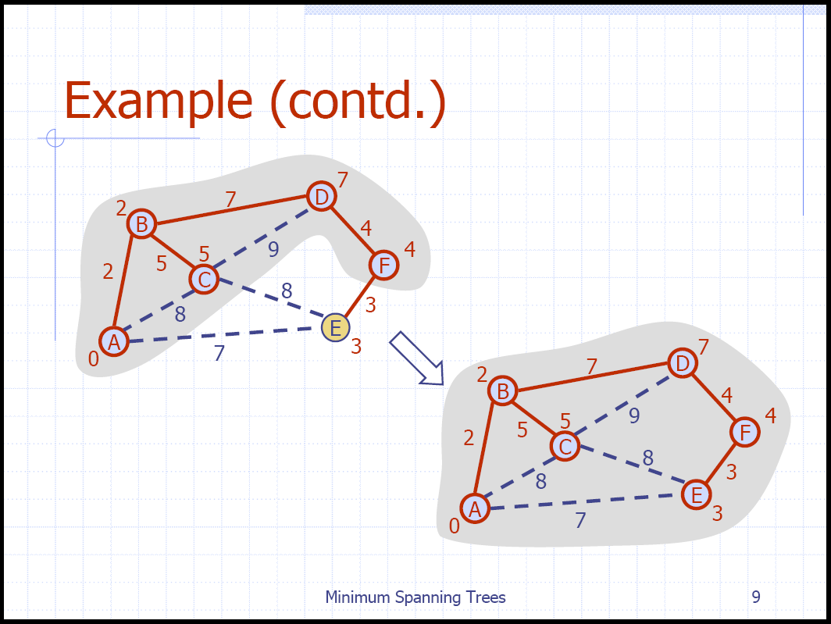
Prim’s Algorithm Example

Slide 58
Kruskal’s algorithm Algo
T = empty spanning tree; E = set of edges; N = number of nodes in graph;
while T has fewer than N - 1 edges {
remove an edge (v, w) of lowest cost from E
if adding (v, w) to T would create a cycle
then discard (v, w)
else add (v, w) to T
}
Finding an edge of lowest cost can be done just by sorting the edges
Efficient testing for a cycle requires a fairly complex algorithm (UNION-FIND) which we don’t cover in this course

Slide 59
Kruskal’s Algorithm
Created in 1957 by Joseph Kruskal
Finds the MST by taking the smallest weight in the graph and connecting the two nodes and repeating until all nodes are connected to just one tree
This is done by creating a priority queue using the weights as keys
Each node starts off as it’s own tree
While the queue is not empty, if the edge retrieved connects two trees, connect them, if not, discard it
Once the queue is empty, you are left with the minimum spanning tree

Slide 60
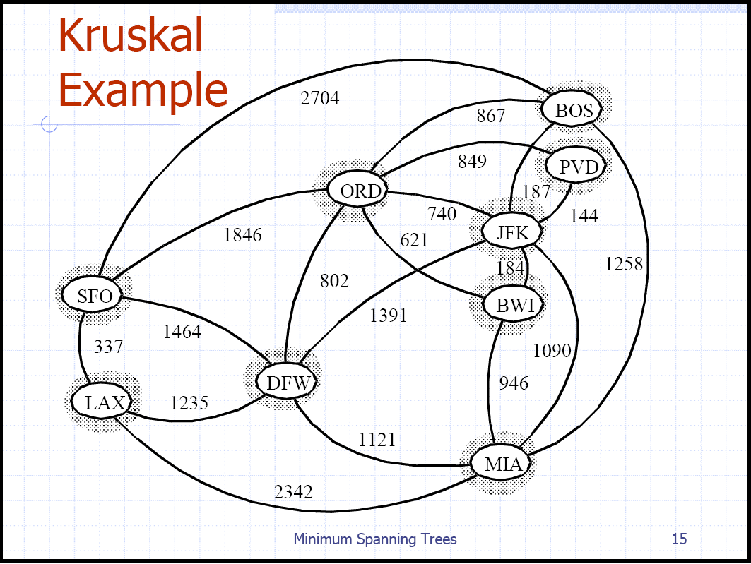
Kruskal’s Algorithm Example

Slide 61
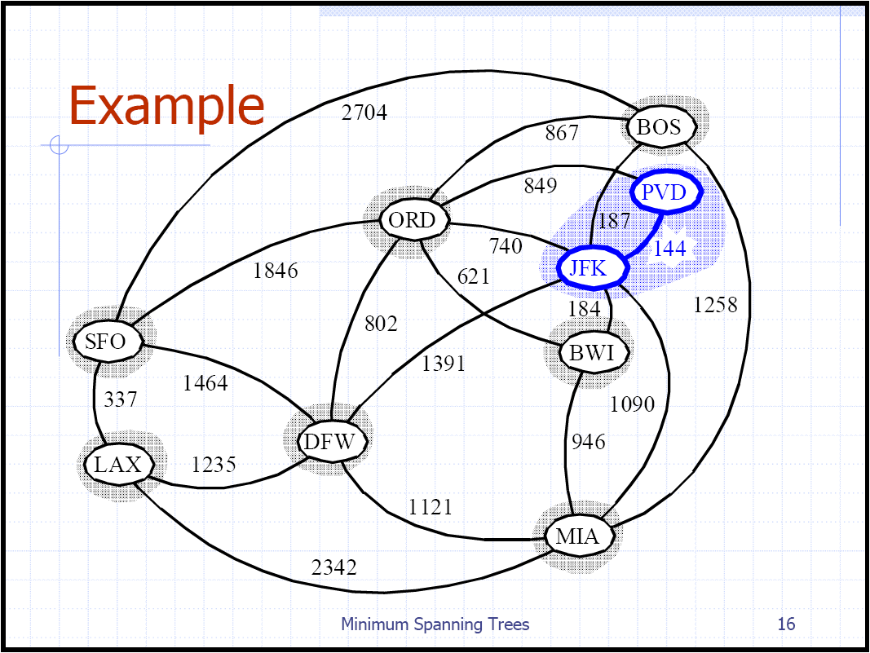
Kruskal’s Algorithm Example

Slide 62
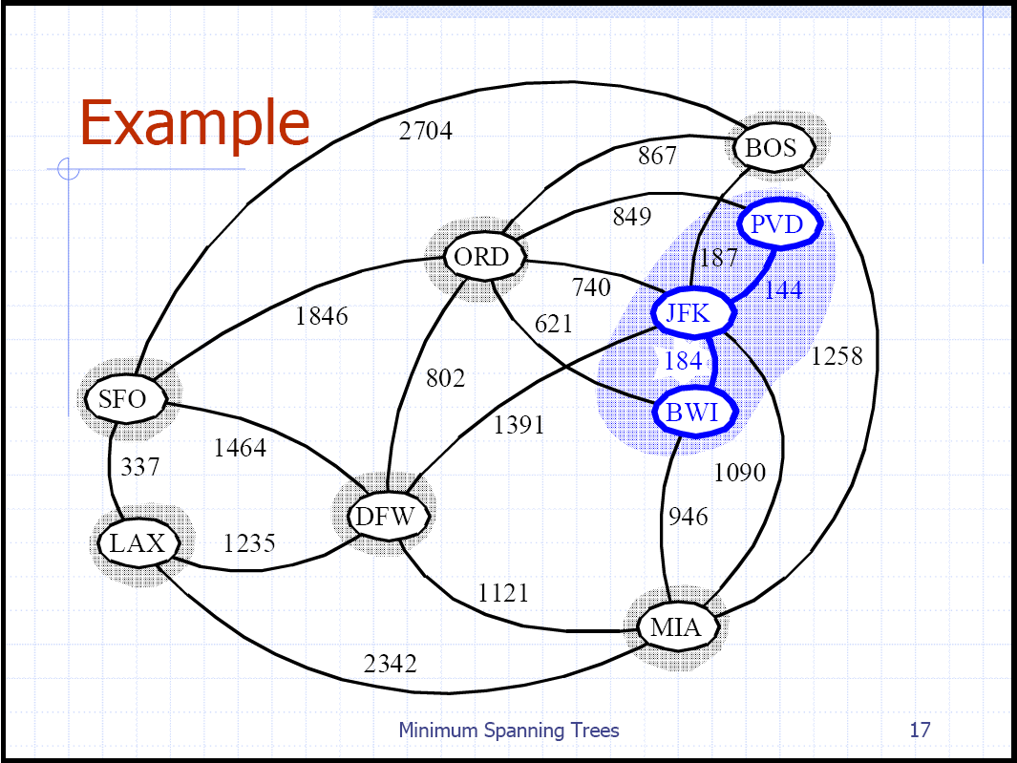
Kruskal’s Algorithm Example

Slide 63
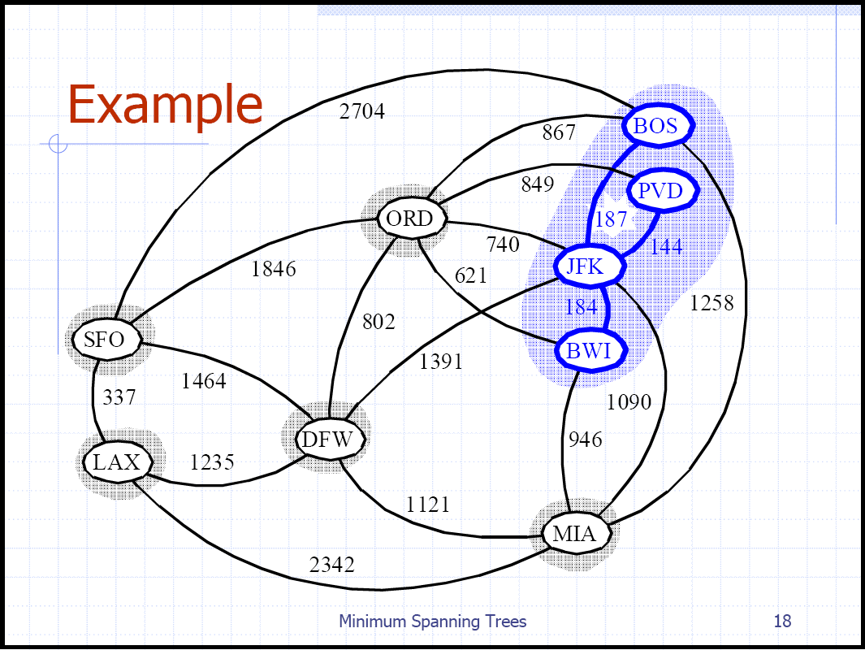
Kruskal’s Algorithm Example

Slide 64
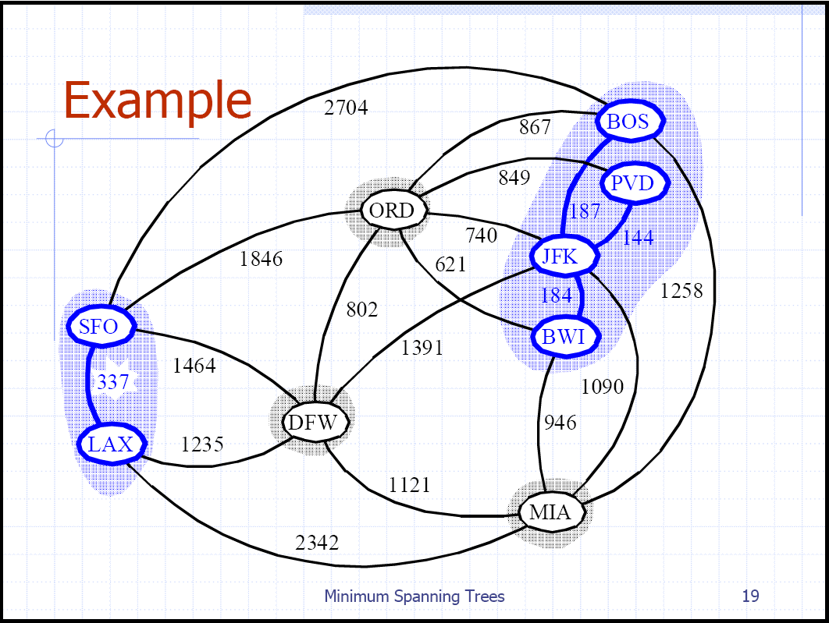
Kruskal’s Algorithm Example

Slide 65
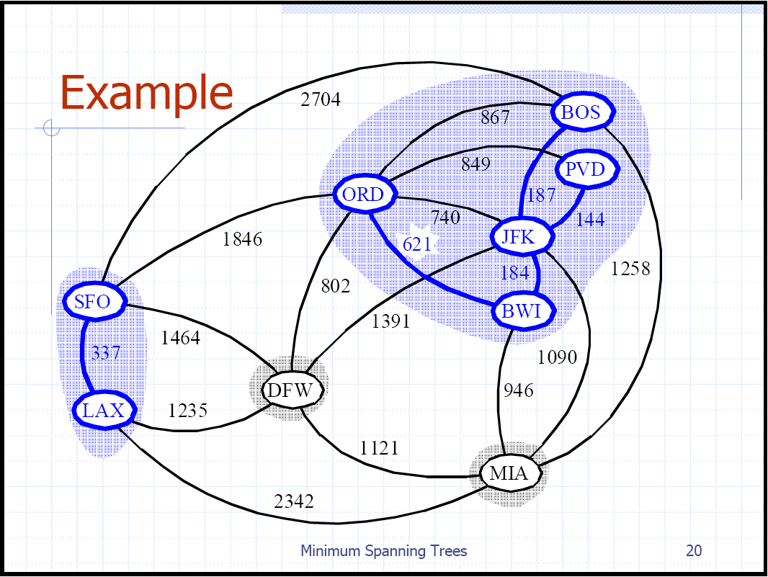
Kruskal’s Algorithm Example

Slide 66

Kruskal’s Algorithm Example

Slide 67
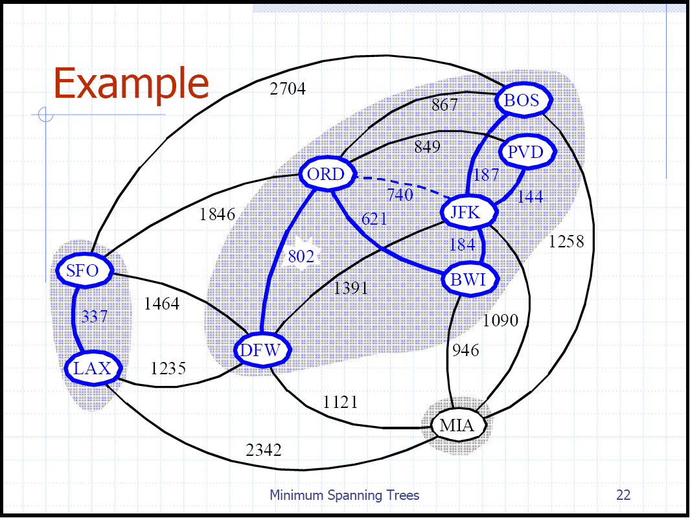
Kruskal’s Algorithm Example

Slide 68
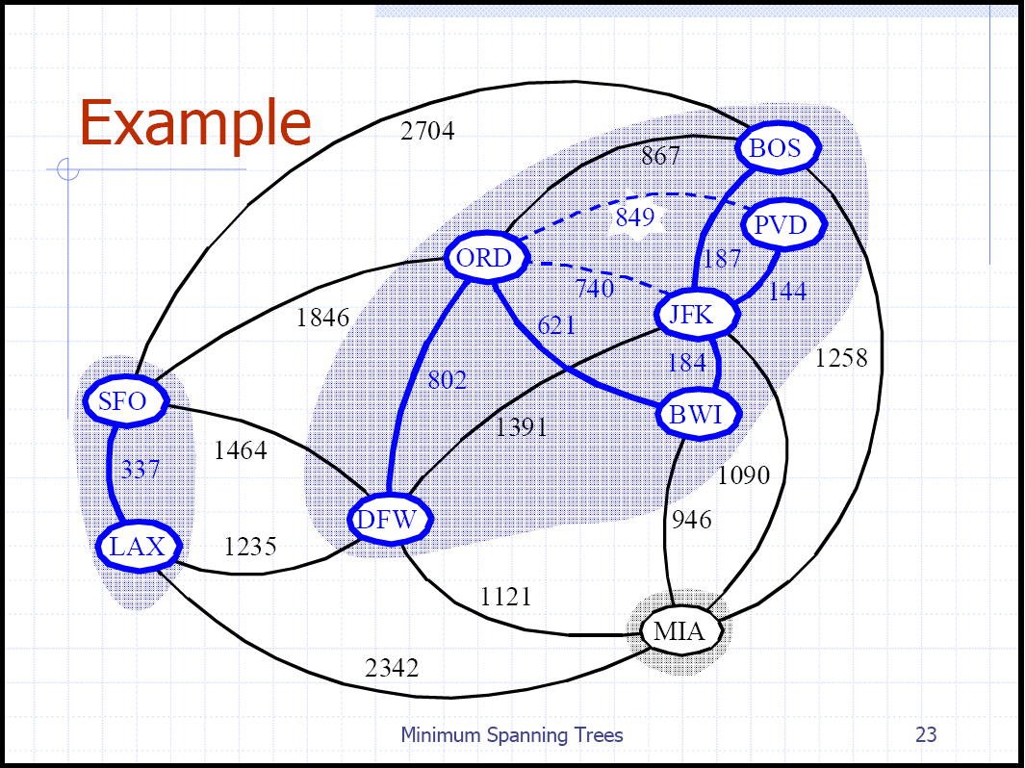
Kruskal’s Algorithm Example

Slide 69
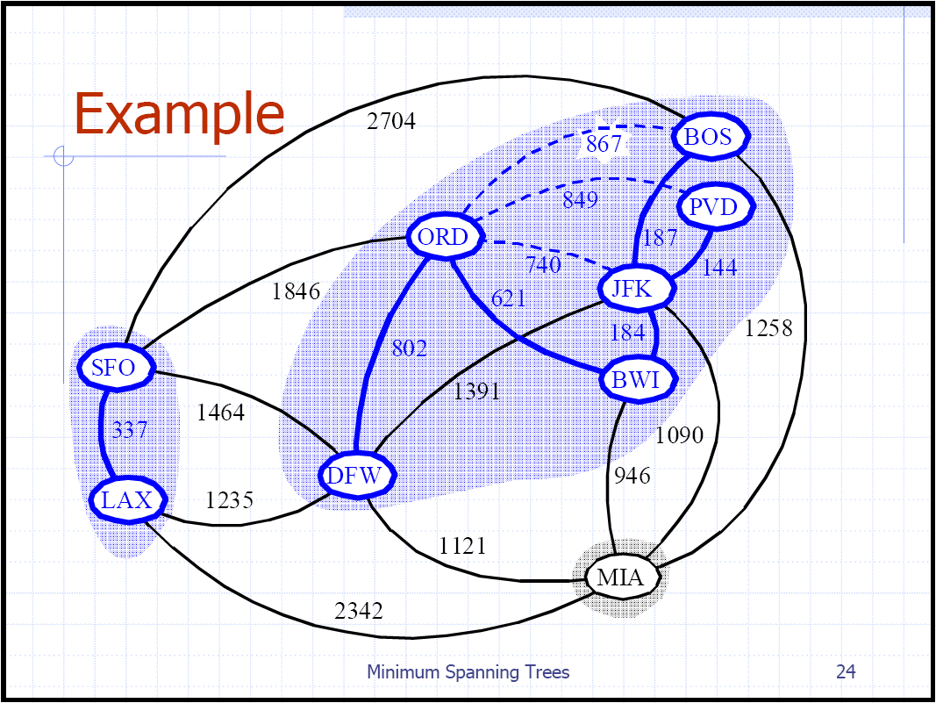
Kruskal’s Algorithm Example

Slide 70
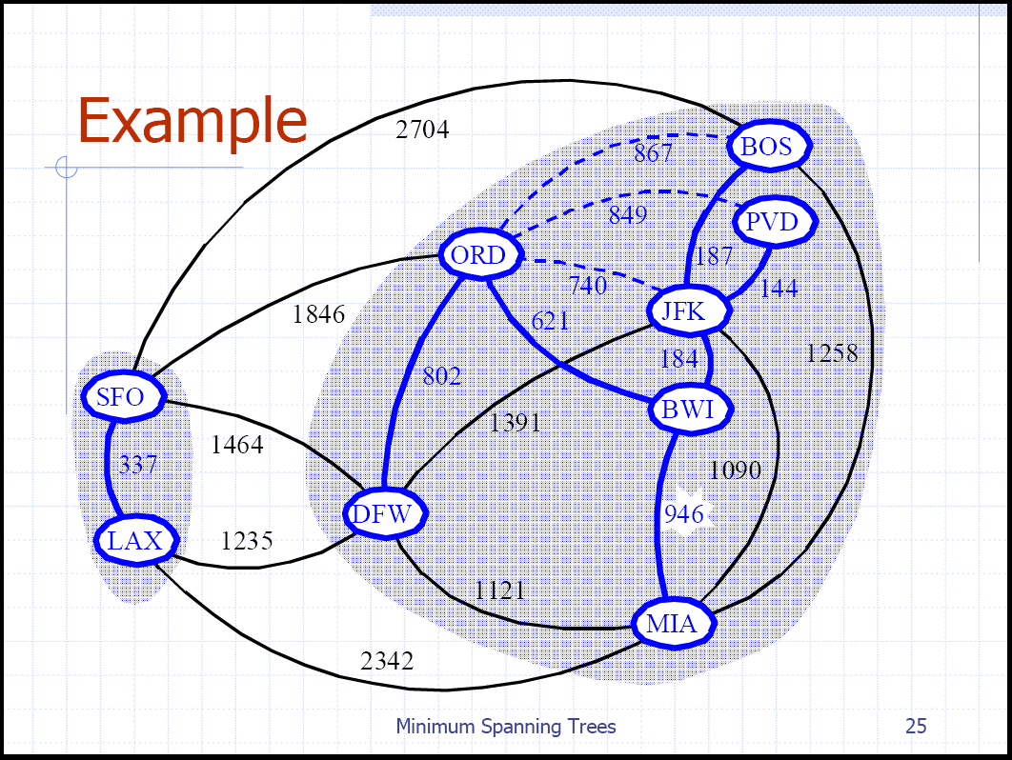
Kruskal’s Algorithm Example

Slide 71
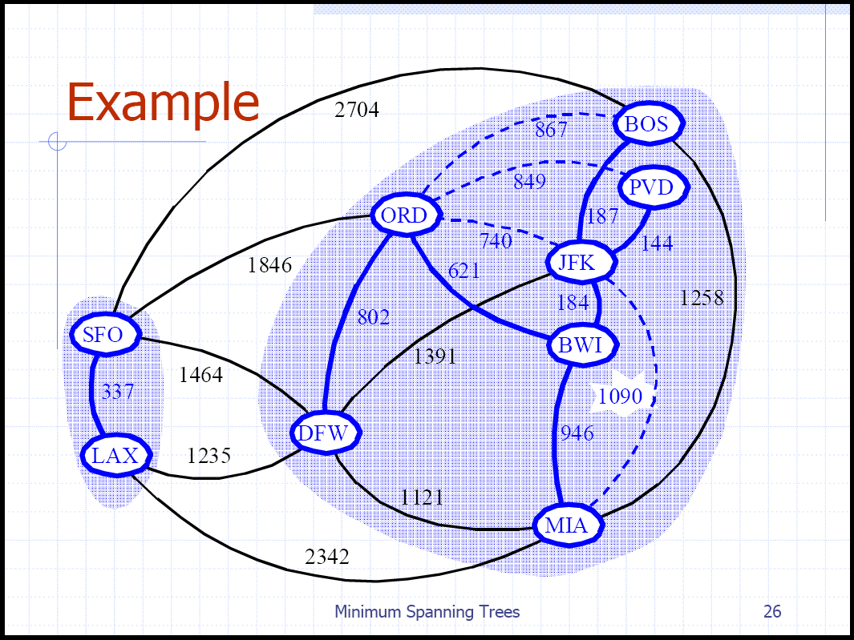
Kruskal’s Algorithm Example

Slide 72
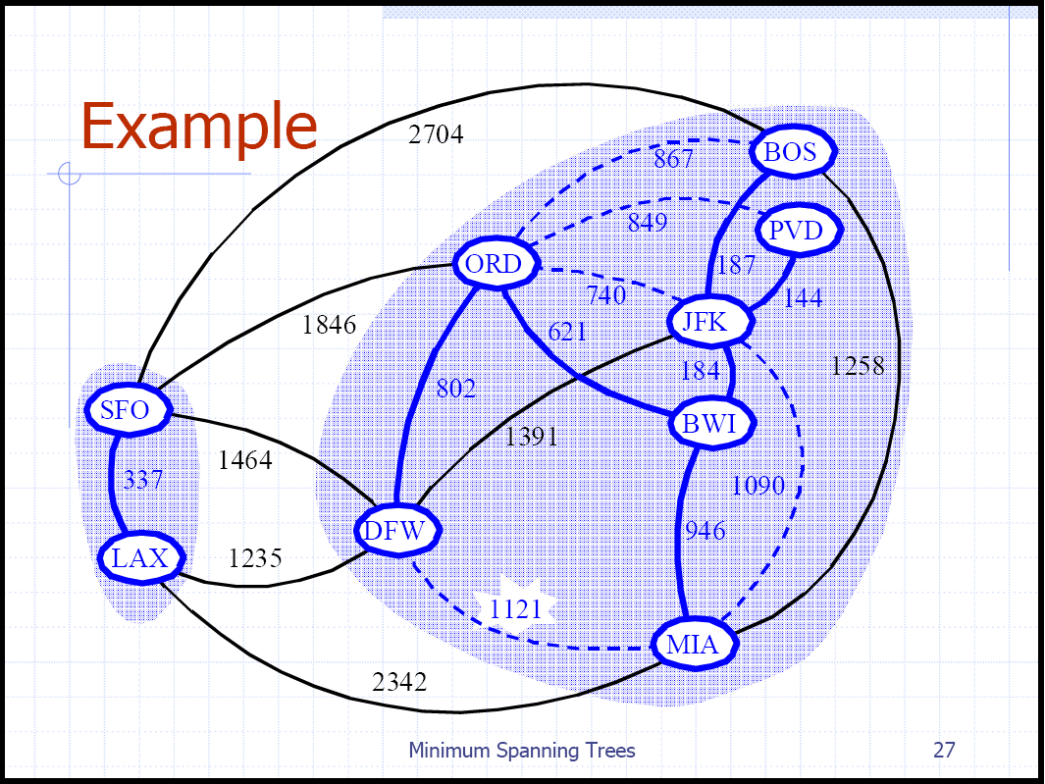
Kruskal’s Algorithm Example

Slide 73
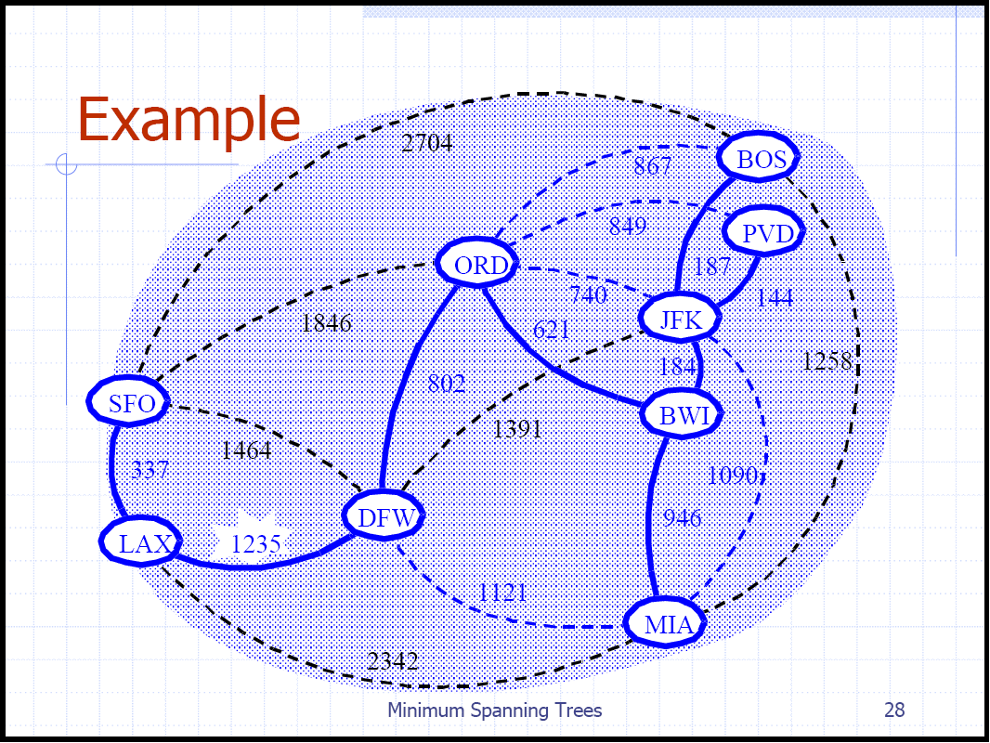
Kruskal’s Algorithm Example

Slide 74
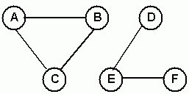
Connectedness of an Undirected Graph
An undirected graph G = (V, E) is connected if there is a path between every pair of vertices.
Although the figure below appears to be two graphs, it is actually a single graph.
Clearly, G is not connected. e.g. no path between A and D.
G consists of two unconnected parts, each of which is a connected sub-graph --- connected components.
V = {A, B, C, D, E, F}
E = {{A, B}, {A, C}, {B, C}, {D, E}, {E, F}}

Slide 75
Implementation of Connectedness Algorithm
A simple way to test for connectedness in an undirected graph is to use either depth-first or breadth-first traversal - Only if all the vertices are visited is the graph connected. The algorithm uses the following visitor:
public class CountingVisitor extends AbstractVisitor {
protected int count;
public int getCount(){ return count;}
public void visit(Object obj) {count++;}
}
Using the CountingVisitor, the isConnected method is implemented as follows:
public boolean isConnected() {
CountingVisitor visitor = new CountingVisitor();
Iterator i = getVertices();
Vertex start = (Vertex) i.next();
breadthFirstTraversal(visitor, start);
return visitor.getCount() == numberOfVertices;
}

Slide 76
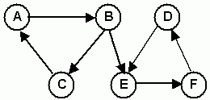
Connectedness of a Directed Graph
A directed graph G = (V, E) is strongly connected if there is a directed path between every pair of vertices.
Is the directed graph below connected?
G is not strongly connected. No path between any of the vertices in {D, E, F}
However, G is weakly connected since the underlying undirected graph is connected.
V = {A, B, C, D, E, F}
E = {(A, B), (B, C), (C, A), (B, E), (D, E), (E, F), (F, D)

Slide 77
Implementation of Strong Connectedness Algorithm
A simple way to test for strong connectedness is to use |V| traversals - The graph is strongly connected if all the vertices are visited in each traversal.
public boolean isStronglyConnected() {
if (!this.isDirected())
throw new InvalidOperationException(
"Invalid for Undirected Graph");
Iterator it = getVertices();
while(it.hasNext()) {
CountingVisitor visitor = new CountingVisitor();
breadthFirstTraversal(visitor, (Vertex) it.next());
if(visitor.getCount() != numberOfVertices)
return false;
}
return true;
}

Slide 78
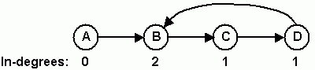
Cycles in a Directed Graph
An easy way to detect the presence of cycles in a directed graph is to attempt a topological order traversal.
This algorithm visits all the vertices of a directed graph if the graph has no cycles.
In the following graph, after A is visited and removed, all the remaining vertices have in-degree of one.
Thus, a topological order traversal cannot complete. This is because of the presence of the cycle { B, C, D, B}.
public boolean isCyclic() {
CountingVisitor visitor = new CountingVisitor();
topologicalOrderTraversal(visitor);
return visitor.getCount() != numberOfVertices;
}

Slide 79
ALGORITHM TO GENERATE ALL SPANNING TREES
Click here

Slide 80
ALGORITHM 1: GENERATE SPANNING TREES IN ORDER OF INCREASING COST
Input: Graph G(V,E) and weight function w
Output: Output_File (all spanning trees of G, sorted in order of increasing cost)
List = {A}
Calculate_MST (A)
while MST ≠ ∅ do
Get partition P^{s} ∈ List that contains the smallest spanning tree
Write MST of P^{s} to Output_File
Remove P^{s} from List
Partition(P^{s}).

Slide 81
PROCEDURE PARTITION (P)
P¹ = P² = P;
for each edge i in P do
if i not included in P and not excluded from P then
make i excluded from P¹;
make i included in P²;
Calculate_MST (P¹);
if Connected (P¹) then
add P¹ to List;
P¹ = P²;

Slide 82
Topological Sort
topological sort or topological ordering of a directed graph is a linear ordering of its vertices such that for every directed edge uv from vertex u to vertex v, u comes before v in the ordering.
For instance, the vertices of the graph may represent tasks to be performed, and the edges may represent constraints that one task must be performed before another; in this application, a topological ordering is just a valid sequence for the tasks.
A topological ordering is possible if and only if the graph has no directed cycles, that is, if it is a directed acyclic graph (DAG).

Slide 83
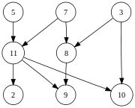
Topological sort
The graph shown to the left has many valid topological sorts, including:
5, 7, 3, 11, 8, 2, 9, 10 (visual left-to-right, top-to-bottom)
3, 5, 7, 8, 11, 2, 9, 10 (smallest-numbered available vertex first)
5, 7, 3, 8, 11, 10, 9, 2 (fewest edges first)
7, 5, 11, 3, 10, 8, 9, 2 (largest-numbered available vertex first)
5, 7, 11, 2, 3, 8, 9, 10 (attempting top-to-bottom, left-to-right)
3, 7, 8, 5, 11, 10, 2, 9 (arbitrary)

Slide 84
Articulation Point
Let G = (V,E) be a connected undirected graph.
Articulation Point: is any vertex of G whose removal results in a disconnected graph.

Slide 85
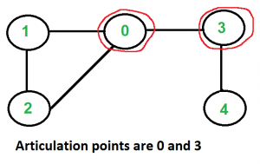
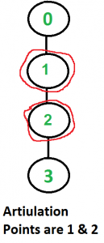
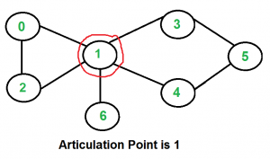
Articulation Point
Articulation Point: is any vertex of G whose removal results in a disconnected graph.

Slide 86
Strongly Connected Components or Biconnected components
A graph is biconnected if it contains no articulation points.
Two edges are cocyclic if they are equal or if there is a simple cycle that contains both edges. (Two different ways of getting from one edge to the other)
This defines an equivalence relation on the edges of the graph
Biconnected components of a graph are the equivalence classes of cocyclicity relation

Slide 87
Strongly Connected Components or Biconnected components
A graph is biconnected if and only if it consists of a single biconnected component
No articulation points

Slide 88
Articulation points and DFS
How to find articulation points?
Use the tree structure provided by DFS
G is undirected: tree edges and back edges (no difference between forward and back edges, no cross edges)
Assume G is connected

Slide 89
a
e
i
d=1
a
2
b
1
8
e
8
b
f
j
3
c
1
9
i
8
c
g
10
4
d
7
f
1
j
8
d
h
3
5
h
3
6
g
3

Slide 90
Max-flow min-cut theorem
the max-flow min-cut theorem states that in a flow network, the maximum amount of flow passing from the source to the sink is equal to the minimum capacity that, when removed in a specific way from the network, causes the situation that no flow can pass from the source to the sink.

Slide 91
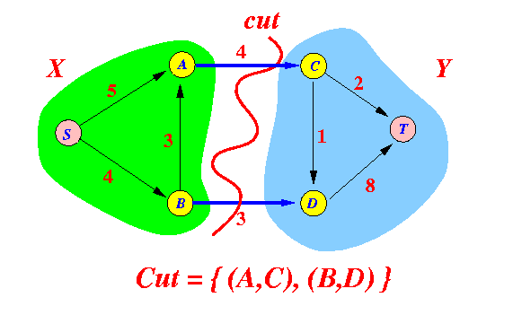
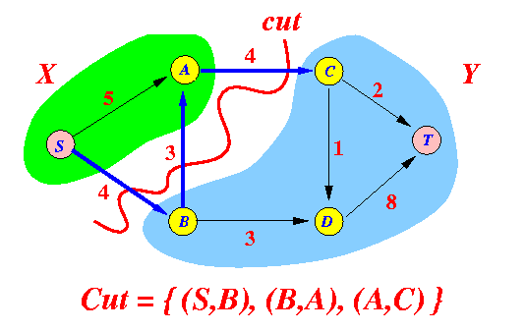
Max-flow min-cut theorem
Cut = a set of edges whose removal will divide/separate the network into 2 halves X and Y where:
(source) S ∈ X and (sink) T ∈ Y
In other words:
Removing the edges in a cut will disconnect the source S from the sink T

Slide 92
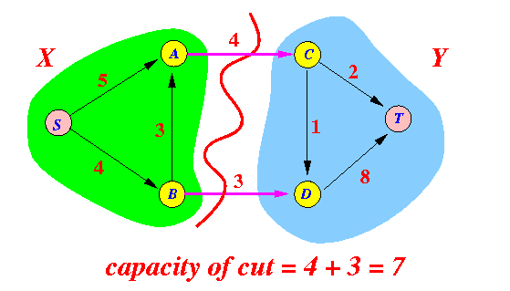
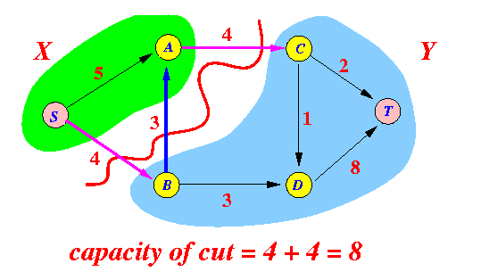
Max-flow min-cut theorem
Capacity of a cut = the sum of the capacity of the edges in the cut that are oriented from a verte x ∈ X to a verte x ∈ Y
Note: These edges can be used to "carry" flow from S → T

Slide 93
Max-flow min-cut theorem
Definition: minimum cut and min. cut capacity
Minimum cut = the cut in the network that has the smallest possible capacity
Minimum cut capacity = the capacity of the minimum cut
Maximum flow = the largest possible flow from source S to sink T
So we can say that
Maximum flow ≤ capacity of minimum cut

Slide 94
Theorem
In any basic network, the value of the maximum flow is equal to the capacity of the minimum cut
I.e.:
maximum flow = capacity of min. cut

Slide 95
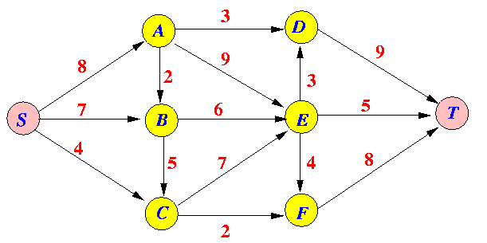
Find a minimum cut in the following basic network:

Slide 96
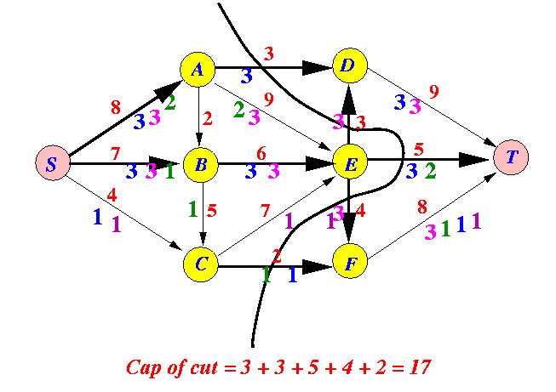
Solution

Slide 97
Ford-Fulkerson Algorithm for Max Flow
The Ford–Fulkerson method or Ford–Fulkerson algorithm (FFA) is an algorithm that computes the maximum flow in a flow network. The idea behind the algorithm is as follows: as long as there is a path from the source to the sink, with available capacity on all edges in the path, we send flow along one of the paths. Then we find another path, and so on. A path with available capacity is called an augmenting path.
Limitations :-
Flow should be integral or rational
On each iteration residual capacity should be integral

Slide 98
The Residual Network
Flow Network
1
(7/8)
(flow / capacity)
(8/10)
f (u, v) / c (u, v)
s
(1/1)
u
v
t
(5/6)
(6/10)
2
Residual Network
Residual capacity r (u ,v)
2
1
1
c (u, f) – f (u, v)
8
7
u
v
s
1
t
1
4
f (u, v)
5
2
6

Slide 99
Augmenting Paths
An augmenting path is a path from s to t in the residual network.
The Residual capacity of augmented path P is
δ(P) = min {r(i, j): (i, j) ∈ P}
Augmentation along P
Add δ(P) in each arc along P in flow network
Modify residual capacities in residual network
r(u, v) = r(u, v) - δ(P) and r(v, u) = r(v, u) + δ(P) for u, v ∈ P
2
1
1
2
1
8
7
8
8
s
1
t
s
1
t
1
4
4
5
2
6
6
2
6

Slide 100
Cut
1
(8/8)
(9/10)
s
(1/1)
t
(6/6)
(7/10)
2
An (S,T)-cut in a flow network G = (V,E) is a partition of
vertices V into two disjoint subsets S and T such that
s ∈ S, t ∈ T
e.g., S = { s, 1 } and T = { 2, t }.
The capacity of a cut (S,T) is
CAP(S,T) = ∑_{u∈S}∑_{v∈T} c(u,v)

Slide 101
The Ford Fulkerson Maximum Flow Method
Begin
x := 0;
create the residual network G(x);
while there is some directed path from s to t in G(x) do
begin
let P be a path from s to t in G(x);
Δ := δ(P);
send Δ units of flow along P;
update the residual capacities;
end
end {the flow x is now maximum}.

Slide 102
Indication of Optimum Flow
1
(8/8)
(9/10)
s
(1/1)
t
(6/6)
(7/10)
2
There is no augmenting path in the residual network.
1
1
9
8
s
1
t
3
6
2
7

Slide 103
Indication of Optimum Flow (Contd.)
1
(8/8)
(9/10)
s
(1/1)
t
(6/6)
(7/10)
2
Flow across the network is equal to the capacity of some cut
(Max Flow Min Cut Theorem)

Slide 104
Ford-Fulkerson Max Flow
4
2
5
3
1
1
1
2
2
s
4
t
3
2
1
3
This is the original network, plus reversals of the arcs.

Slide 105
Ford-Fulkerson Max Flow
4
2
5
3
1
1
1
2
2
s
4
t
3
2
1
3
This is the original network, and the original residual network.

Slide 106
Ford-Fulkerson Max Flow
4
2
5
3
1
1
1
2
2
s
4
t
3
2
1
3
Find any s-t path in G(x)

Slide 107
Ford-Fulkerson Max Flow
4
2
5
3
1
1
1
2
1
2
s
4
t
2
1
3
2
1
1
1
3
Determine the capacity Δ of the path.
Send Δ units of flow in the path. Update residual capacities.

Slide 108
Ford-Fulkerson Max Flow
4
2
5
3
1
1
1
2
1
2
s
4
t
2
1
3
2
1
1
1
3
Find any s-t path

Slide 109
Ford-Fulkerson Max Flow
4
2
5
3
1
1
1
2
1
1
1
s
4
t
2
1
1
3
2
2
1
1
1
1
3
1
Determine the capacity Δ of the path.
Send Δ units of flow in the path. Update residual capacities.

Slide 110
Ford-Fulkerson Max Flow
4
2
5
3
1
1
1
2
1
1
1
s
4
t
2
1
1
3
2
2
1
1
1
1
3
1
Find any s-t path

Slide 111
Ford-Fulkerson Max Flow
4
2
5
3
1
1
1
1
1
1
s
4
t
1
2
1
2
2
3
1
1
1
1
3
1
Determine the capacity Δ of the path.
Send Δ units of flow in the path. Update residual capacities.

Slide 112
Ford-Fulkerson Max Flow
4
2
5
3
1
1
1
1
2
1
1
s
4
t
1
2
1
2
2
3
1
1
1
1
3
1
Find any s-t path

Slide 113
Ford-Fulkerson Max Flow
4
2
5
3
1
1
1
1
2
1
1
s
4
t
1
2
1
1
2
2
1
1
1
2
1
2
3
1
Determine the capacity Δ of the path.
Send Δ units of flow in the path. Update residual capacities.

Slide 114
Ford-Fulkerson Max Flow
4
2
5
3
1
1
1
1
2
1
1
s
4
t
1
2
1
1
2
2
1
1
2
1
2
3
1
Find any s-t path

Slide 115
Ford-Fulkerson Max Flow
4
3
2
5
1
3
1
2
1
1
1
1
s
4
t
1
2
1
1
2
2
1
1
2
1
2
3
1
Determine the capacity Δ of the path.
Send Δ units of flow in the path. Update residual capacities.

Slide 116
Ford-Fulkerson Max Flow
4
3
2
5
1
3
1
2
1
1
1
1
s
4
t
1
2
1
1
2
2
1
1
2
1
2
3
1
There is no s-t path in the residual network. This flow is optimal

Slide 117
Ford-Fulkerson Max Flow
4
3
2
2
5
5
1
3
1
2
1
1
1
1
s
s
4
4
t
1
2
1
1
2
2
1
1
2
1
2
3
1
3
These are the nodes that are reachable from node s.

Slide 118
Ford-Fulkerson Max Flow
1
2
5
1
1
2
2
s
4
t
2
2
3
Here is the optimal flow

